Slide 1

Experience Analytics Hackathon 2023
RACY | Topic 1
12 May 2023

Slide 2

01
Understanding the Problem Statement
02
Value Proposition
03
Our Solution

Slide 3



Understanding the Problem Statement
7
The Client
The Problem
The Purpose
The Client: Sky One is a telecom company operating in an industry with high competition leading thus to increased probability of customer churn
The Problem: Customer churn can significantly impact a company's bottom line. As such, the identification of customers likely to churn as well as the implementation of proactive measures are deemed crucial
The Purpose: Develop a churn prediction model that can help in the (1) reduction of customer churn and (2) improvement of customer retention

Slide 4


Value Proposition
Active monitoring of customers
1
Gain a deep understanding of customers through behavioural patterns indicating the probability of churn and identify those at-risk
Optimisation of services
2
Understand the drivers of churn so as to increase customer retention by taking the appropriate actions in a timely manner
Active monitoring of customers
Optimisation of services
Minimisation of expert judgement
Minimisation of expert judgement
3
Implement data-driven decision-making by removing subjective elements increasing thus accuracy of decisions

Slide 5
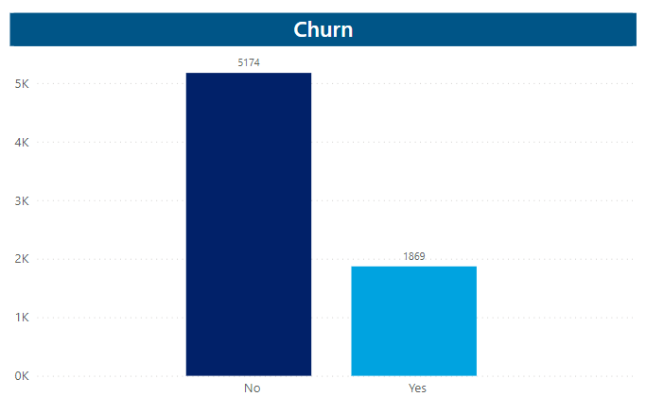
Our Solution
Data processing (1/2)
The first step in building our model was data processing, during which we extracted a number of data insights, set out herein:
Our first observation was that the “No” bucket makes up a large portion of the data while “Yes” appears to be underrepresented reflecting thus an imbalanced dataset
We also noticed that the majority of the data available were categorical variable, which was considered as of critical importance when selecting the appropriate methods to build our churn model

Slide 6
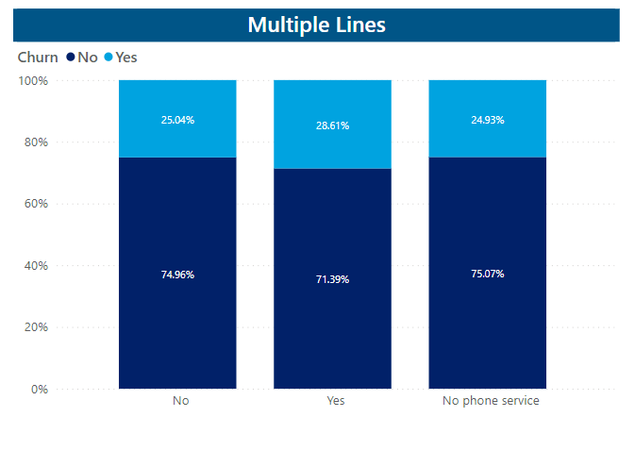
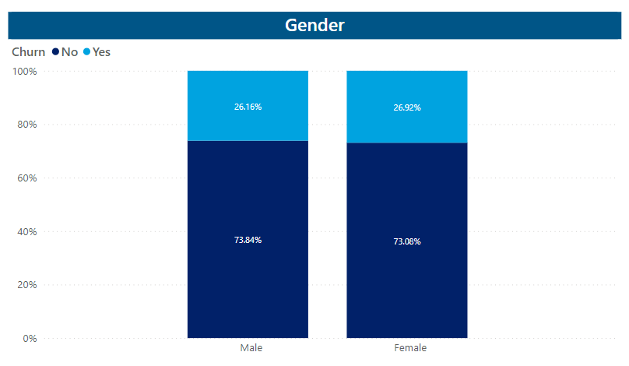
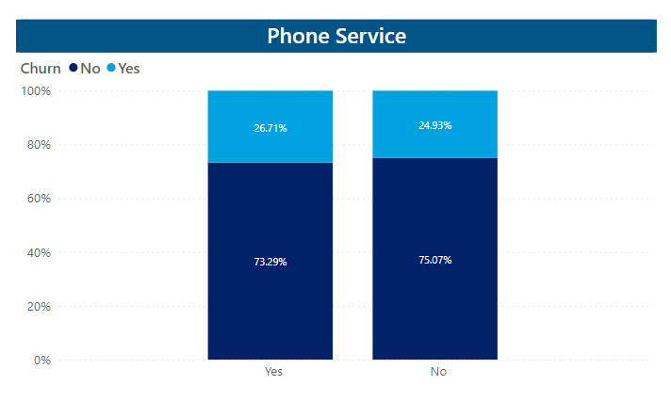
Our Solution
Data processing (2/2)
During our data processing process and our features importance analysis, we identified three (3) features whose effect is not anticipated to be large on the model.
These are:
Multiple Lines
Gender
Phone Service

Slide 7
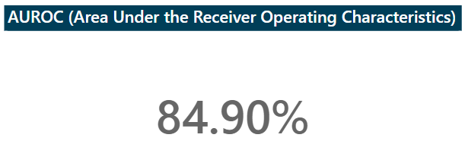
Our Solution
Methodology
Training Set
C1:
CatBoost
C2:
CatBoost_Weight
C3:
XGBoost
Classification Models
Predictions
P1
P2
P3
Voting
Final Prediction

Slide 8
Our Solution
Methodology
In analysing the reason behind customers churning and customers most likely to churn in the future, we built a churn model using the two (2) following supervised machine-learning algorithms.
Works well with categorical data
Uses Gradient boosting – a process in which many decision trees are constructed iteratively, improving each time the result of the previous one
Uses symmetric trees – at every depth level, all the decision nodes use the same split condition vectorising thus decisions
Embeds data pre-processing using ordered encoding – encoding categorical features, considering the target statistics from all the rows prior to a data point in order to calculate a value to replace the categorical feature
Implements gradient-boosting decision trees (similar to CatBoost)
Handles well missing data and large datasets efficiently
Includes regularisation techniques preventing thus overfitting
Allows for cross-validation at each iteration of the boosting process enabling thus getting the exact optimum number of boosting iterations in a single run
CatBoost
XGBoost
Voting Classifier

